Slide 1
Lecture 29
November 15th , 2019
Truly great job hanging in there in lab. Lots of new concepts introduced. Two different concepts:
  3-point recombination mapping
  Regulation of gene expression
  Let’s wrap up 3-point mapping. This weekend, try the linkage problems uploaded to the website.

Slide 2
3 basic requirements for successful 3-point mapping
Organism doing the X.O/ recombination must be heterozygous for all loci under consideration
Cross design must allow for direct observation of crossing over in gametes as a phenotype in offspring.
  In X-linked gene mapping, the mate contributes only recessive alleles or Y chromosome.
Sufficient numbers of offspring must be examined to recover a representative sample of all crossover classes.

Slide 3
Knowing the design of the cross, 3 types of offspring should be evident.
  Non-crossover (NCO). Offspring derived from gametes in which no crossover occurred in the interval of interest.
  Single-cross-over (SCO) Offspring derived from gametes in which crossover occurred in one of the 2 intergene regions. **2 different SCO are produced.
  Double cross-over (DCO) Offspring derived from gametes in which crossover occurred in both intergene regions of interest.

Slide 4
NCO (parental combinations) will be the most frequent--Although XO happens, it can happen anywhere along the chromosome. Not always in the interval you are analyzing.
DCO will be the least frequent
SCO1
SCO 2
will show intermediate frequencies reflecting the intergene distances.

Slide 5
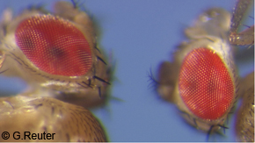
Textbook example…
3 X-linked genes in example
w-white eyes
y-yellow body 3 recessive mutations
ec-echinus (eye shape)

Slide 6
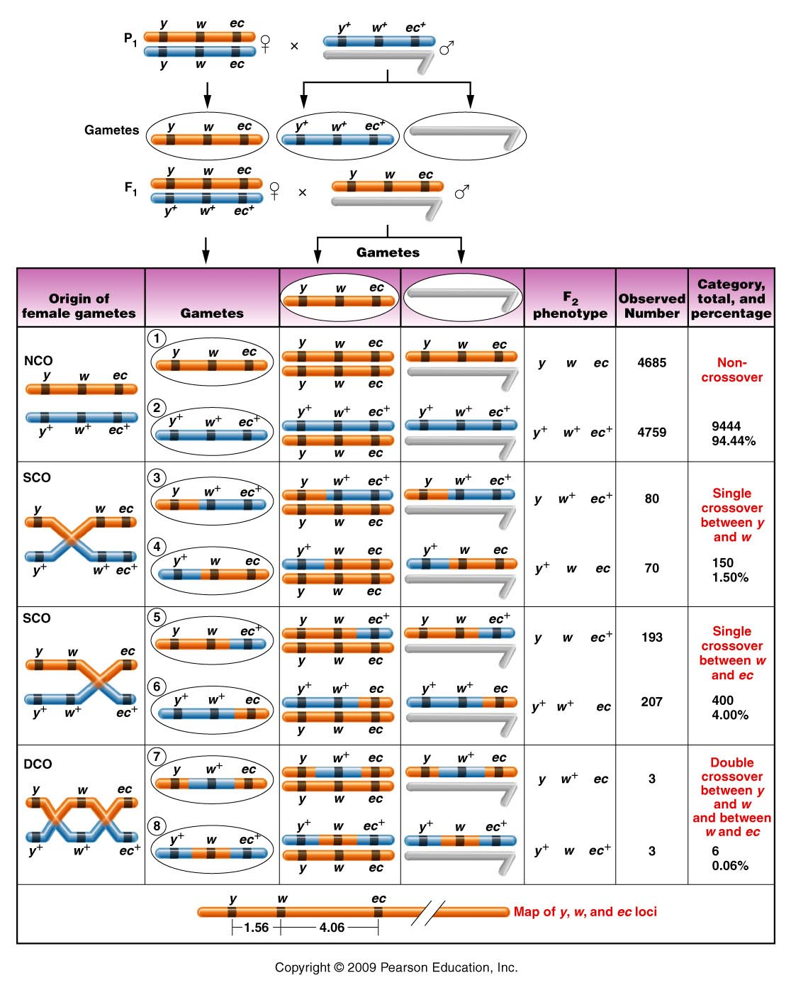
Cross is made to produce female heterozygote and completely recessive male.
Figure 5.8
Notes:
6
Figure 5-8 A three-point mapping cross involving the yellow (y or y⁺), white (w or w⁺), and echinus (ec or ec⁺) genes in Drosophila melanogaster. NCO, SCO, and DCO refer to noncrossover, single-crossover, and double-crossover groups, respectively. Centromeres are not drawn on the chromosomes, and only two nonsister chromatids are initially shown in the left-hand column.

Slide 7
What are the possible orders for 3 genes?
y-ec-w (w-ec-y)
y-w-ec (ec-w-y)
w-y-ec (ec-y-w)

Slide 8
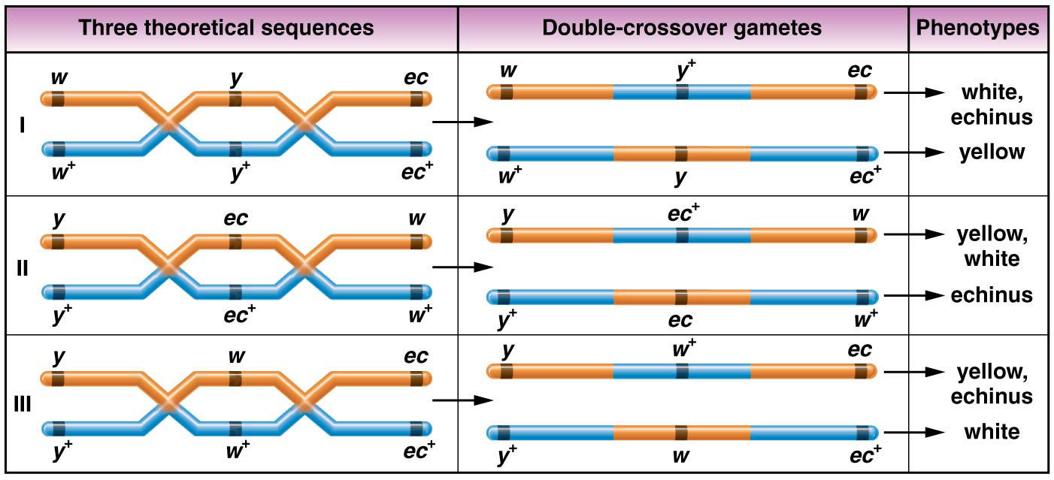
The three possible sequences of the white, yellow, and echinus genes and the results of a double crossover in each case.

Slide 9
Go back to the table, and identify how the genes would change to make DCO.
Play with the orders to turn NCO to DCO.
The order should be revealed.

Slide 10
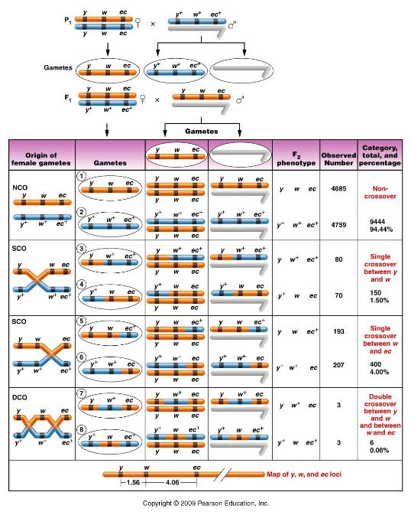
Which offspring
were DCO from
the data?

Slide 11
Which offspring
were DCO from
the data?

Slide 12
Your data shows DCO are consistent with w in the middle.
Reorder your data to identify the 2 different SCO categories….

Slide 13
Determining the distances…
Distance is determined as before…using recombination frequency.
Recombination is sum of SCO (for that interval) and DCO, since DCO occur in both intervals.

Slide 14
Determining the distances…
1.56 cM
4.06 cM
y
w
ec
SCO = 1.5%
DCO = 0.6%
SCO = 4.0%
DCO = 0.6%

Slide 15
Now sketch the cross (cross A) that we have set up with our flies and review how we will be able to map the X-linked genes, y, cv, and f.
Try the 3 different orders. Predict DCO offspring in each case. Your understanding of this will make data analysis easy! Be ready.
Do this---ON PAPER. Have it with you next Monday.

Slide 16
Next Thursday---I will be here for the morning lab, but not the afternoon.
Thursday will be an independent opportunity to analyze F2 flies. I will help get organized so that each lab will have flies to analyze if possible.
More detail next week.

Slide 17
Returning to Nucleic acid chemistry…
Nucleic acids----DNA and RNA
Both are polymers (repeating units) of nucleotides.

Slide 18
Nucleotides…
3 components
  5-carbon (pentose) sugar
  Nitrogenous base
  PO₄ group(s)
  1 PO₄ group =nucleoside monophosphate
  2 PO₄ groups =nucleoside diphosphate
  3 PO₄ groups =nucleoside triphosphate
Nucleoside

Slide 19
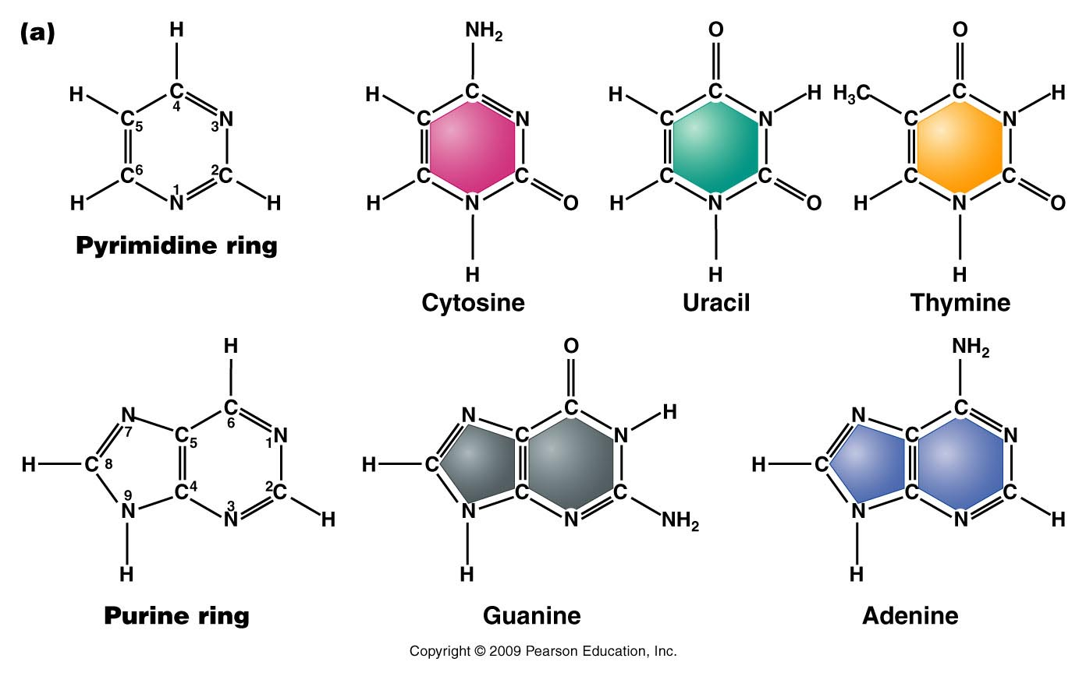
The bases---Do not memorize atomic structure but recognize pyrimidine vs. purine—note all contain nitrogen.
The nitrogen and carbon atoms are numbered.
Figure 10.9a
Notes:
Figure 10-9a (a) Chemical structures of the pyrimidines and purines that serve as the nitrogenous bases in RNA and DNA. The nomenclature for numbering carbon and nitrogen atoms making up the two bases is shown within the structures that appear on the left. (b) Chemical ring structures of ribose and 2-deoxyribose, which serve as the pentose sugars in RNA and DNA, respectively.Web Tutorial 10.1DNA Structure

Slide 20
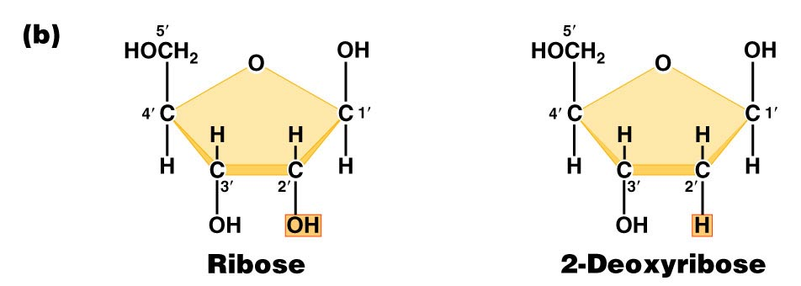
Pentose sugars in RNA and DNA
DRAW THEM!! Note the numbering of atoms
(1’, 2’….carbons).
Found in RNA
Found in DNA
Figure 10.9b
Notes:
Figure 10-9b (a) Chemical structures of the pyrimidines and purines that serve as the nitrogenous bases in RNA and DNA. The nomenclature for numbering carbon and nitrogen atoms making up the two bases is shown within the structures that appear on the left. (b) Chemical ring structures of ribose and 2-deoxyribose, which serve as the pentose sugars in RNA and DNA, respectively.Web Tutorial 10.1DNA Structure

Slide 21
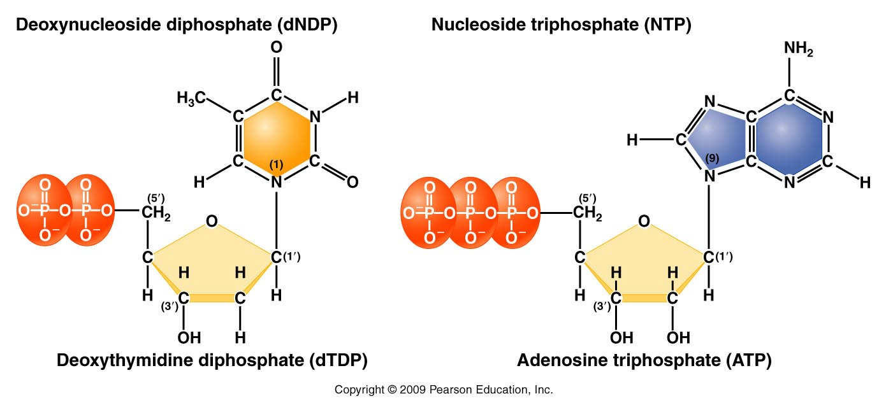
Complete structure of nucleotides
Nitrogenous base forms bond with the 1’ carbon of the sugar
Phosphate forms bond with the 5’carbon of the sugar
d=deoxyribose
no “d”= ribose
Figure 10.11
Notes:
Figure 10-11 Basic structures of nucleoside diphosphates and triphosphates, as illustrated by deoxythymidine diphosphate and deoxyadenosine triphosphate

Slide 22
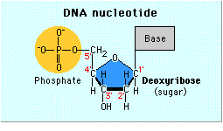
Sketch a nucleotide—show this level of detail
Need not show atomic detail of all bases
Need to show carbon numbering of the sugar
Phosphate groups
Thymine

Slide 23
When talking about any or all RNA or DNA building blocks we us “N” to designate any/all of the bases. For example, dNTP—could be dATP, dCTP, dTTP, or dGTP. If dNPT is plural (dNTPs), we are referring to all 4 DNA nucleotides.
Recognize small differences in structure/chemical make up!
Be sure to be able to distinguish between:
dNTPs and NTPs
dNMPs, dNDPs, dNTPs
Be able to recognize a stretch of RNA from a single strand of DNA….

Slide 24
By the way….Nucleotides serve various functions
Nucleic acid (RNA and DNA) building blocks* (our focus here)
Energy molecules (ATP/GTP)
Signaling molecules (cAMP)

Slide 25
DNA/RNA made of chemically linked nucleotides
Specific type of linkage joins adjacent nucleotides
  5’ carbon of one nucleotide forms a linkage to the 3’ carbon of the adjacent nucleotide
    Phosphate links 2 nucleotides in a phophodiester bond

Slide 26
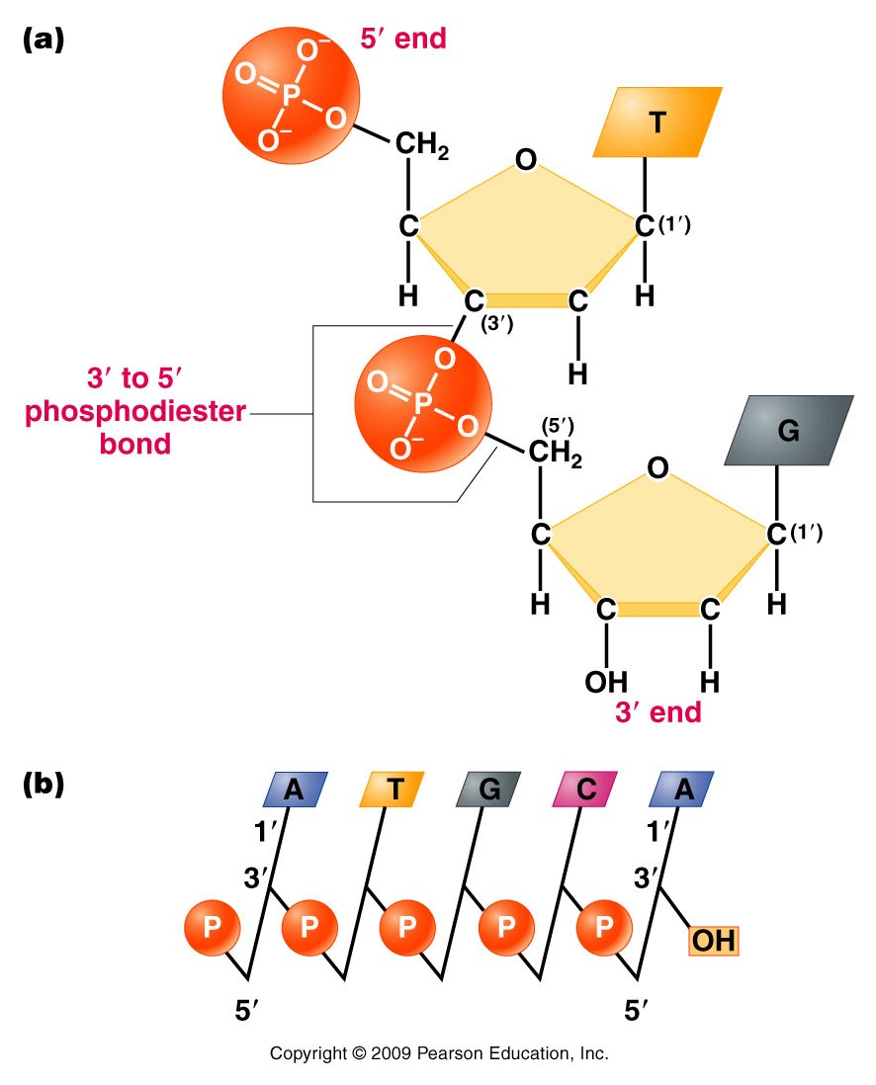
Result is a 5’-3’ linkage and a molecule with 5’ and 3’ ends.
A strand of DNA/RNA
Figure 10.12
Notes:
Figure 10-12 (a) Linkage of two nucleotides by the formation of a C-3’ –C-5’ (3’ –5’) phosphodiester bond, producing a dinucleotide. (b) Shorthand notation for a polynucleotide chain.

Slide 27
RNA exists as a single strand* of nucleotides
DNA is a double strand of nucleotides
  Strands are connected via non-covalent bonds between specific bases.
    Adenine bonds to Thymine
    Cytosine bonds to Guanine
    * adenine and uracil (and cytosine and guanine) can form bonds in regions of an RNA single strand or in DNA-RNA hybrids.
Complementary base pairing

Slide 28
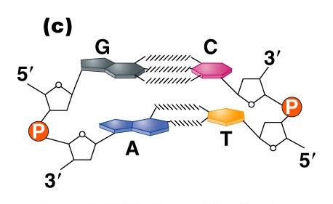
Figure 10.14c
Notes:
Figure 10_14c (a) The DNA double helix as proposed by Watson and Crick. The ribbonlike strands constitute the sugar-phosphate backbones, and the horizontal rungs constitute the nitrogenous base pairs, of which there are 10 per complete turn. The major and minor grooves are apparent. The solid vertical bar represents the central axis. (b) A detailed view depicting the bases, sugars, phosphates, and hydrogen bonds of the helix. (c) A demonstration of the antiparallel nature of the helix and the horizontal stacking of the bases.

Slide 29
Complementary base pairing requires the DNA strands run in opposite directions with respect to 5’ and 3’ ends. (Antiparallel strands)
Complementary base pairing is only possible with a slight twist to each successive base pair. The twisting to accommodate pairing, creates the helical molecule.

Slide 30
(How do we know)? Determining DNA structure…
Double helix is 63 years old!! (knowledge of DNA structure) Published April 25th, 1953.
Watson JD. Crick FHC. A structure for deoxyribose nucleic acid. 1953; Nature 171:737-8.
  Watson and Crick got most of the glory…but the discovery of the structure was a very much a group effort.

Slide 31
It began with biochemical studies…
Erwin Chargaff—studied DNA by base composition.
  Noted roughly equal concentrations of:
    Purines and Pyrimidines
    Specifically: [A] = [T] and [C] =[G]

Slide 32
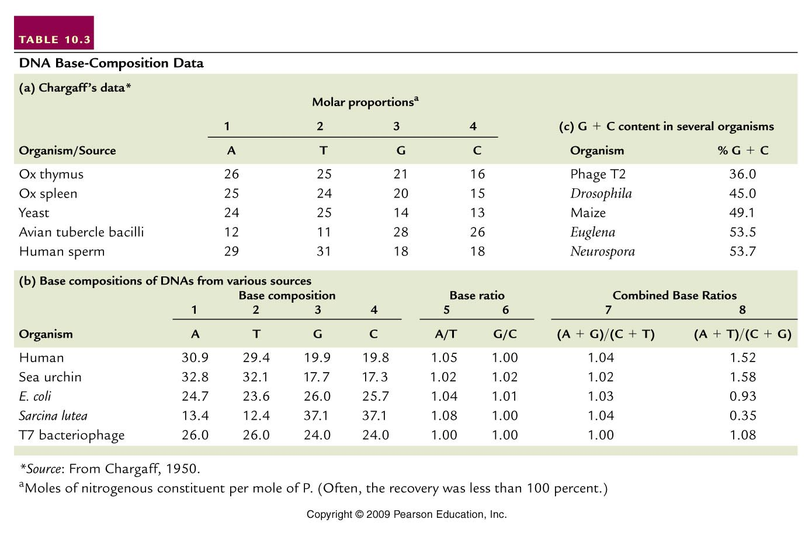
(purines=pyrimidines)
(A+T not = G +C)
Table 10.3
Notes:
Table 10.3 DNA Base Composition Data

Slide 33
  Suggested 1:1 interactions of specific bases.
  A-T and G-C
  Eventually this biochemical ratio supported the specific A-T and G-C base-pairing scheme which facilitates the interaction of 2 DNA strands.

Slide 34
  Interestingly---different species have different base compositions---Some are more A/T rich some are more G/C rich.
  Humans have more A-T base-pairs than G-C base pairs.
  A bacterial species—Sarcinia lutea has more G-C than A-T base pairs.

Slide 35
(purines=pyrimidines)
(A+T not = G +C)
Table 10.3
Notes:
Table 10.3 DNA Base Composition Data

